Slide 1
Exploration of viruses in ballast and harbor waters around the Great Lakes
Yiseul Kim
May 1, 2014

Slide 2
Study objectives
Taxonomic profiling of ballast and harbor water viromes
Functional profiling of ballast and harbor water viromes
Virome comparison between ballast and harbor waters

Slide 3
Dataset
Illumina HiSeq 2500 (2 × 100 bp)
Sample name | Sample type | # Reads | Total length (Gbp) | %GC
AB | Ballast water | 81,819,466 | 8.2 | 47
BB | Ballast water | 55,195,294 | 5.5 | 48
IB | Ballast water | 62,910,326 | 6.3 | 46
MB | Ballast water | 107,604,262 | 10.8 | 50
PB | Ballast water | 52,520,860 | 5.3 | 43
BH | Harbor water | 48,435,448 | 4.8 | 50
IH | Harbor water | 36,241,288 | 3.6 | 48
MH | Harbor water | 106,295,946 | 10.6 | 49
SUM |  | 551,022,890 | 55.1
Notes:
70 M reads / virome

Slide 4
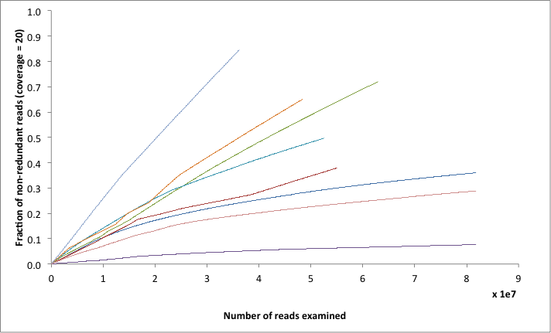
Information saturation curve
IH
IB
BH
PB
BB
AB
MH
MB
Notes:
Generating a saturation curve for shotgun data: You can use normalize-by-median.py to assess information saturation in your shotgun data.
Information saturation curve suggests more information needed.

Slide 5
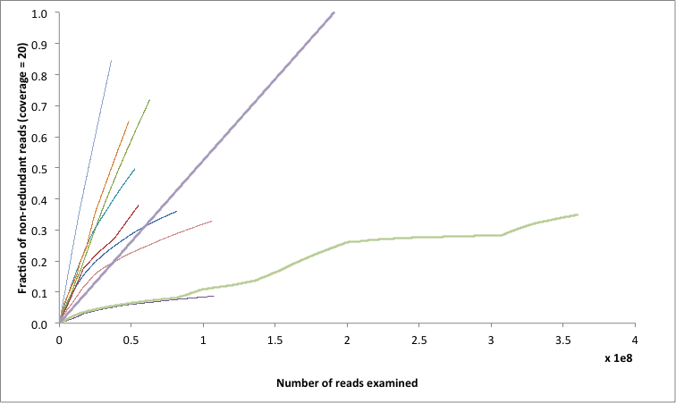
Information saturation curve
HW
IH
IB
BH
PB
BB
AB
BW
MH
MB

Slide 6
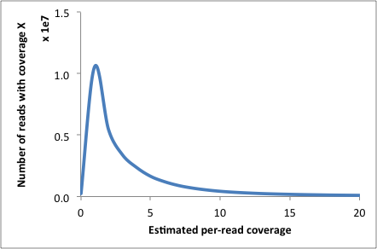
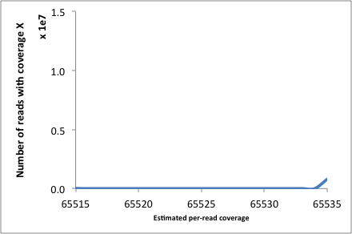
Read coverage spectrum
BH, IB, IH, PB: Many reads with low coverage and some with very high coverage
Notes:
Need ~5 times more sequencing: assemblers do not work well with reads < 20x coverage.

Slide 7
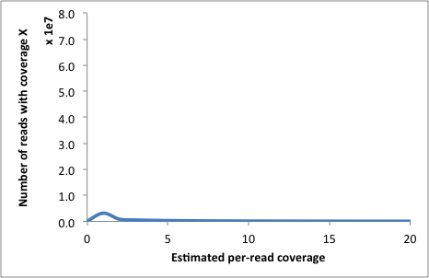
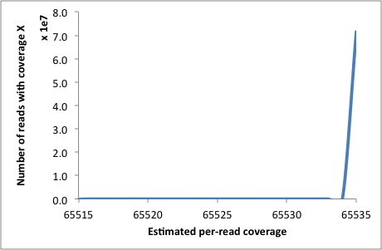
Read coverage spectrum
AB, BB, MB, MH: Some reads with low coverage and many with very high coverage
Notes:
Many sequence reads are from small, high coverage genomes (probably phage); this “dilutes” sequencing.

Slide 8
Assembly summary
Sample | # Contigs | Total contig length (bp) | Mean contig length (bp) | Max contig length (bp) | Min contig length (bp) | Mapping back rate (%)
BW | 325,774 | 213,666,567 | 655 | 42,056 | 200 | 82.07
HW | 421,605 | 214,859,888 | 509 | 11,242 | 200 | 67.61
AB | 152,622 | 91,527,913 | 599 | 14,586 | 200 | 86.4
BB | 33,948 | 19,623,949 | 578 | 10,832 | 200 | 72.0
IB | 60,839 | 36,611,033 | 601 | 30,707 | 202 | 45.4
MB | 15,346 | 9,433,717 | 614 | 13,131 | 200 | 97.2
PB | 93,709 | 72,562,784 | 774 | 39,143 | 200 | 82.6
BH | 127,026 | 60,595,926 | 477 | 8,376 | 201 | 51.9
IH | 101,117 | 46,257,024 | 457 | 11,406 | 200 | 32.2
MH | 230,847 | 120,300,520 | 521 | 7,909 | 200 | 83.1
For assembly, IDBA-UD was used with default parameters.
For mapping, bowtie2-local was used with default parameters.

Slide 9
Sample contribution to sub-master assembly
Sample | Master assembly | Mapping back rate (%)
AB | BW | 86.6
BB | BW | 75.1
IB | BW | 50.1
MB | BW | 97.8
PB | BW | 84.3
BH | HW | 54.4
IH | HW | 34.9
MH | HW | 83.4
BW is co-assembly of ballast water samples (AB, BB, IB, MB, PB).
HW is co-assembly of harbor water samples (BH, IH, MH).
For mapping, bowtie2-local was used with default parameters.

Slide 10
Sample contribution to master assembly
Sample | Master assembly | Mapping back rate (%)
AB | GL | 87.4
BB | GL | 76.6
IB | GL | 51.5
MB | GL | 97.9
PB | GL | 84.6
BH | GL | 56
IH | GL | 35.7
MH | GL | 83.6
GL is co-assembly of all samples.
For mapping, bowtie2-local was used with default parameters.

Slide 11
Annotation summary
Sample name | # Contigs | # Not assigned | # No hits | # Low complexity | # Assigned
BW | 325,774 | 25,080 | 217,329 | 2 | 83,363 (25.6%)
HW | 421,605 | 30,084 | 320,454 | 1 | 71,066 (16.9%)
AB | 152,622 | 11,224 | 108,799 | 2 | 32,597 (21.4%)
BB | 33,948 | 2,693 | 22,297 | 3 | 8,955 (26.4%)
IB | 60,839 | 4,815 | 38,697 | 2 | 17,325 (28.5%)
MB | 15,346 | 928 | 11,432 | 2 | 2,984 (19.4%)
PB | 93,709 | 7,486 | 57,259 | 2 | 28,962 (30.9%)
BH | 127,026 | 9,305 | 95,415 | 2 | 22,304 (17.6%)
IH | 101,117 | 6,746 | 80,277 | 1 | 14,093 (13.9%)
MH | 230,847 | 16,361 | 173,627 | 2 | 40,857 (17.7%)
Contigs were compared against NCBI viral genome database using BLASTx (e-value of 0.001).
The BLAST output was parsed by MEGAN’s lowest common ancestor algorithm.
Notes:
No hits: None of the blast hits reached the minimum bitscore
Not assigned: The sequence did not have enough hits to be classified to a taxon (Min support & Top percentage)

Slide 12
Virome comparison (1)
Assembly-bound and annotation-bound
Sample name | % Reads mapped to assemblies | % Contigs assigned | % Contigs from contamination | % Contigs available for comparison
AB | 86.4 | 21.4 | 0.9 | 18.3
BB | 72.0 | 26.4 | 2.0 | 18.6
IB | 45.4 | 28.5 | 8.3 | 11.9
MB | 97.2 | 19.4 | 0.0 | 18.9
PB | 82.6 | 30.9 | 2.4 | 24.9
BH | 51.9 | 17.6 | 0.3 | 9.1
IH | 32.2 | 13.9 | 0.0 | 4.5
MH | 83.1 | 17.7 | 0.3 | 14.7
AVERAGE | 61.2 | 22.0 | 1.8 | 15.1
Reads belonging to Parvovirus NIH-CQV are assumed to be originated from contaminated Qiagen spin columns (reference).

Slide 13
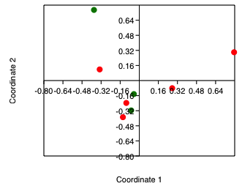
Virome comparison (1)
Assembly-bound and annotation-bound
IH
IB
MB
BB
MH
PB
BH
AB

Slide 14
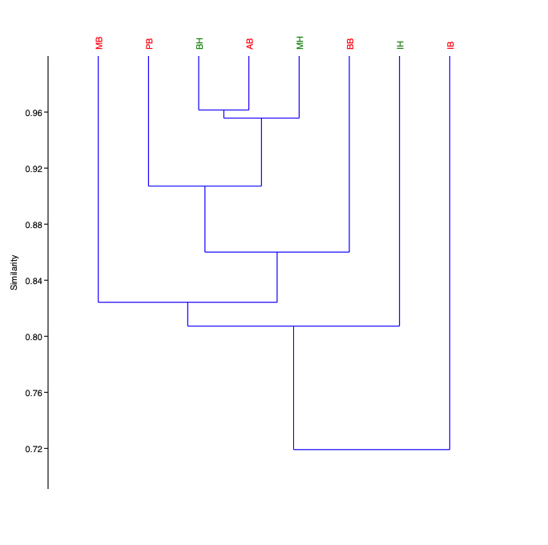
Virome comparison (1)
Based on assembly-bound and annotation-bound
MB
PB
BH
AB
MH
BB
IH
IB

Slide 15
Virome comparison (2)
Assembly-bound and annotation-free
Sample name | % Reads mapped to assemblies | % Contigs assigned | % Contigs from contamination | % Contigs available for comparison
AB | 86.4 | 21.4 | 0.9 | 86.4
BB | 72.0 | 26.4 | 2.0 | 72.0
IB | 45.4 | 28.5 | 8.3 | 45.4
MB | 97.2 | 19.4 | 0.0 | 97.2
PB | 82.6 | 30.9 | 2.4 | 82.6
BH | 51.9 | 17.6 | 0.3 | 51.9
IH | 32.2 | 13.9 | 0.0 | 32.2
MH | 83.1 | 17.7 | 0.3 | 83.1
AVERAGE | 61.2 | 22.0 | 1.8 | 61.2
Reads belonging to Parvovirus NIH-CQV are assumed to be originated from contaminated Qiagen spin columns (reference).

Slide 16
Virome comparison (2)
Assembly-bound and annotation-free
Pairwise comparison between viromes using tBLASTx
 | AB | BB | IB | MB | PB | BH | IH | MH
AB | 100.0 | 45.8 | 49.6 | 32.8 | 53.0 | 65.2 | 56.3 | 72.5
BB | 80.7 | 100.0 | 74.5 | 59.7 | 79.1 | 78.5 | 69.7 | 81.7
IB | 77.1 | 66.7 | 100.0 | 50.0 | 78.6 | 69.9 | 62.6 | 75.0
MB | 78.7 | 71.5 | 68.6 | 100.0 | 76.7 | 73.5 | 78.0 | 81.7
PB | 77.7 | 67.0 | 74.0 | 54.9 | 100.0 | 69.9 | 63.6 | 74.9
BH | 67.4 | 42.8 | 44.0 | 29.3 | 47.3 | 100.0 | 53.9 | 71.3
IH | 49.0 | 27.4 | 29.2 | 26.0 | 33.2 | 44.2 | 100.0 | 58.3
MH | 62.7 | 36.3 | 38.7 | 25.2 | 42.4 | 58.9 | 50.3 | 100.0

Slide 17
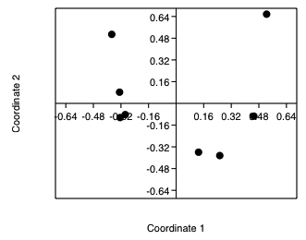
Virome comparison (2)
Assembly-bound and annotation-free
IH
MB
BB
PB
IB
MH
AB
BH

Slide 18
Virome comparison (2)
Assembly-bound and annotation-free
Pairwise comparison between viromes using Nucmer
 | AB | BB | IB | MB | PB | BH | IH | MH
AB | 100.00 | 9.89 | 5.01 | 7.45 | 1.85 | 5.94 | 3.87 | 3.24
BB | 2.13 | 100.00 | 4.35 | 14.26 | 4.68 | 4.53 | 2.23 | 2.04
IB | 2.01 | 8.16 | 100.00 | 5.01 | 4.60 | 1.97 | 1.38 | 0.97
MB | 0.77 | 6.81 | 1.27 | 100.00 | 1.73 | 0.90 | 0.68 | 0.50
PB | 1.46 | 17.28 | 9.07 | 13.21 | 100.00 | 1.32 | 0.82 | 0.68
BH | 3.95 | 13.95 | 3.23 | 5.76 | 1.11 | 100.00 | 4.69 | 3.85
IH | 1.99 | 5.28 | 1.74 | 3.46 | 0.52 | 3.62 | 100.00 | 1.89
MH | 4.27 | 12.43 | 3.15 | 6.39 | 1.13 | 7.63 | 4.83 | 100.00

Slide 19
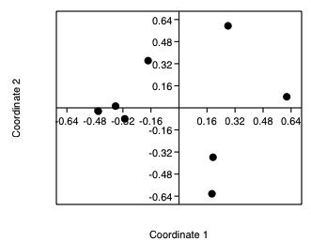
Virome comparison (2)
Assembly-bound and annotation-free
IB
AB
PB
IH
BH
MH
BB
MB

Slide 20
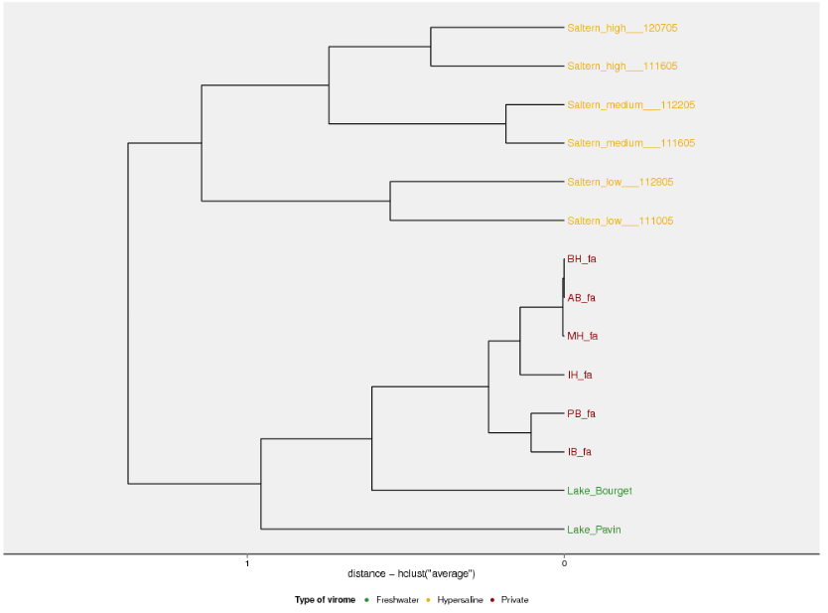
Virome comparison (2)
Assembly-bound and annotation-free
Saltern-high
Saltern-high
Saltern-medium
Hypersaline
Saltern-medium
Saltern-low
Saltern-low
BH
AB
MH
Freshwater
(Great Lakes)
IH
PB
IB
Lake-Bourget
Freshwater
(French lakes)
Lake-Pavin

